Slide 1
Output Device: Computer Display

Slide 2
Computer display monitor
A computer display monitor, usually called simply a monitor, is a piece of electronic equipment which displays viewable images generated by a computer without producing a permanent record. The word "monitor" is used in other contexts; in particular in television broadcasting, where a television picture is displayed to a high standard. A computer display device is usually either a cathode ray tube or some form of flat panel such as a LCD. The monitor comprises the display device, circuitry to generate a picture from electronic signals sent by the computer, and an enclosure or case. Within the computer, either as an integral part or a plugged-in interface, there is circuitry to convert internal data to a format compatible with a monitor.

Slide 3
Computer display monitor…
Aspect Ratio and Viewable Area
Two measures describe the size of your display: the aspect ratio and the screen size. Historically, computer displays, like most televisions, have had an aspect ratio of 4:3. This means that the ratio of the width of the display screen to the height is 4 to 3. For widescreen LCD monitors, the aspect ratio is 16:9 (or sometimes 16:10 or 15:9). Widescreen LCD displays are useful for viewing DVD movies in widescreen format, playing games and displaying multiple windows side by side. High definition television (HDTV) also uses a widescreen aspect ratio.

Slide 4
Computer display monitor…
Aspect Ratio and Viewable Area …
All types of displays include a projection surface, commonly referred to as the screen. Screen sizes are normally measured in inches from one corner to the corner diagonally across from it. This diagonal measuring system actually came about because the early television manufacturers wanted to make the screen size of their TVs sound more impressive.

Slide 5
Computer display monitor…
Aspect Ratio and Viewable Area …
Interestingly, the way in which the screen size is measured for CRT and LCD monitors is different. For CRT monitors, screen size is measured diagonally from outside edges of the display casing. In other words, the exterior casing is included in the measurement as seen below.

Slide 6
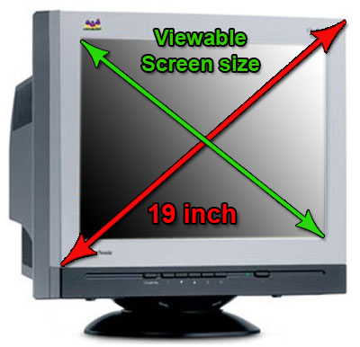
Computer display monitor…
CRT screen size
CRT screen size
CRT screen size

Slide 7
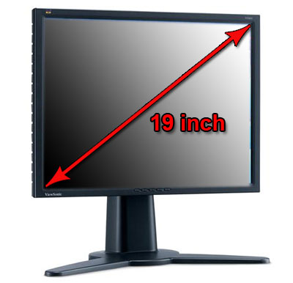
Computer display monitor…
LCD screen size

Slide 8
Computer display monitor…
Aspect Ratio and Viewable Area …
Because of the differences in how CRT and LCD monitors are measured, a 17-inch LCD display is comparable to a 19-inch CRT display. For a more accurate representation of a CRT's size, find out its viewable screen size. This is the measurement of a CRT display without its outside casing. Popular screen sizes are 15, 17, 19 and 21 inches. Notebook screen sizes are smaller, typically ranging from 12 to 17 inches.

Slide 9
Computer display monitor…
Aspect Ratio and Viewable Area …
Obviously, the size of the display directly affects resolution. The same pixel resolution is sharper on a smaller monitor and fuzzier on a larger monitor because the same number of pixels is spread out over a larger number of inches. An image on a 21-inch monitor with an 800x600 resolution will not appear nearly as sharp as it would on a 15-inch display at 800x600.

Slide 10
Computer display monitor…
Standards and Resolution
Resolution refers to the number of individual dots of color, known as pixels, contained on a display. Resolution is expressed by identifying the number of pixels on the horizontal axis (rows) and the number on the vertical axis (columns), such as 800x600. Resolution is affected by a number of factors, including the size of the screen.

Slide 11
Common Display Standards and Resolutions
Standard | Resolution | Typical Use
XGA (Extended Graphics Array) | 1024x768 | 15- and 17-inch CRT monitors and 15-inch LCD monitors
SXGA (Super XGA) | 1280x1024 | 15- and 17-inch CRT monitors 17-and 19-inch LCD monitors
UXGA (Ultra XGA) | 1600x1200 | 19-, 20-, 21-inch CRT monitors 20-inch LCD monitors
QXGA (Quad XGA | 2048x1536 | 21-inch and larger CRT monitors

Slide 12
Imaging technologies
As with television, several different hardware technologies exist for displaying computer-generated output:
Cathode ray tube (CRT)
Liquid crystal display (LCD).
Plasma display
Surface-conduction electron-emitter display (SED)
Organic light-emitting diode (OLED) display

Slide 13
Connections
To display information on a monitor, your computer sends the monitor a signal. The signal can be in analog or digital format.
Analog (VGA) Connection
Because most CRT monitors require the signal information in analog (continuous electrical signals or waves) form and not digital (pulses equivalent to the binary digits 0 and 1), they typically use an analog connection.

Slide 14
Analog (VGA) Connection
However, computers work in a digital world. The computer and video adapter convert digital data into analog format. A video adapter is an expansion card or component that provides the ability to convert display information into a signal that is sent to the monitor. It can also be called a graphics adapter, video card or graphics card. Once the display information is in analog form, it is sent to the monitor through a VGA cable. The cable connects at the back of the computer to an analog connector (also known as a D-Sub connector) that has 15 pins in three rows. See the diagram below:

Slide 15
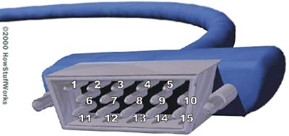
Analog (VGA) Connection

Slide 16
Analog (VGA) Connection
1: Red out | 6: Red return (ground) | 11: Monitor ID 0 in
2: Green out | 7: Green return (ground) | 12: Monitor ID 1 in or data from display
3: Blue out | 8: Blue return (ground) | 13: Horizontal Sync out
4: Unused | 9: Unused | 14: Vertical Sync
5: Ground | 10: Sync return (ground) | 15: Monitor ID 3 in or data clock
Notes:
DDC means display data channel. VGA connector pins 11, 12, and 15 as a serial bus for a Display Data Channel (DDC).^{[9]}

Slide 17
Analog (VGA) Connection
You can see that a VGA connector like this has three separate lines for the red, green and blue color signals, and two lines for horizontal and vertical sync signals. In a normal television, all of these signals are combined into a single composite video signal. The separation of the signals is one reason why a computer monitor can have so many more pixels than a TV set. Because a VGA (analog) connector does not support the use of digital monitors, the Digital Video Interface (DVI) standard was developed.

Slide 18
Digital Video Interface (DVI) Connection
DVI keeps data in digital form from the computer to the monitor. There's no need to convert data from digital information to analog information. LCD monitors work in a digital mode and support the DVI format. (Although, some also accept analog information, which is then converted to digital format.) At one time, a digital signal offered better image quality compared to analog technology. However, analog signal processing technology has improved over the years and the difference in quality is now minimal.

Slide 19
Digital Video Interface (DVI) Connection
The DVI specification is based on Silicon Image's Transition Minimized Differential Signaling (TMDS) and provides a high-speed digital interface. A transmitter on the video adapter sends the digital information to a receiver in the monitor. TMDS takes the signal from the video adapter, determines the resolution and refresh rate that the monitor is using, and spreads the signal out over the available bandwidth to optimize the data transfer from computer to monitor.

Slide 20
Digital Video Interface (DVI) Connection
DVI cables can be a single link cable that uses one TMDS transmitter or a dual link cable with two transmitters. A single link DVI cable and connection supports a 1920x1080 image, and a dual link cable/connection supports up to a 2048x1536 image .

Slide 21
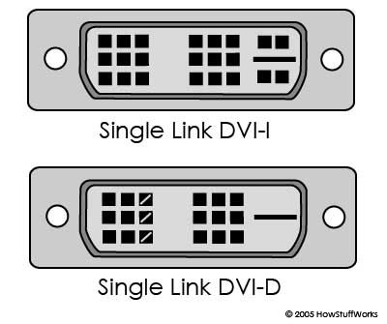
Digital Video Interface (DVI) Connection

Slide 22
Digital Video Interface (DVI) Connection
There are two main types of DVI connections:
DVI-digital (DVI-D)
DVI-integrated (DVI-I)
DVI-digital (DVI-D) is a digital-only format. It requires a video adapter with a DVI-D connection and a monitor with a DVI-D input. The connector contains 24 pins/receptacles in 3 rows of 8 plus a grounding slot for dual-link support. For single-link support, the connector contains 18 pins/receptacles.

Slide 23
Digital Video Interface (DVI) Connection
DVI-integrated (DVI-I) supports both digital and analog transmissions. This gives you the option to connect a monitor that accepts digital input or analog input. In addition to the pins/receptacles found on the DVI-D connector for digital support, a DVI-I connector has 4 additional pins/receptacles to carry an analog signal.

Slide 24
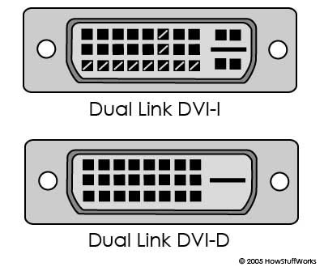
Digital Video Interface (DVI) Connection

Slide 25
CRT (Cathode Ray Tube) Monitors
The cathode ray tube (CRT) is an evacuated glass envelope containing an electron gun (a source of electrons) and a fluorescent screen, usually with internal or external means to accelerate and deflect the electrons. When electrons strike the fluorescent screen, light is emitted. The electron beam is deflected and modulated in a way which causes it to display an image on the screen. The image may represent electrical waveforms (oscilloscope), pictures (television, computer monitor), echoes of aircraft detected by radar, etc.

Slide 26
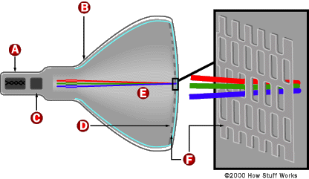

CRT (Cathode Ray Tube) Monitors

Slide 27
CRT (Cathode Ray Tube) Monitors
A CRT monitor contains millions of tiny red, green, and blue phosphor dots that glow when struck by an electron beam that travels across the screen to create a visible image.
The terms anode and cathode are used in electronics as synonyms for positive and negative terminals. For example, you could refer to the positive terminal of a battery as the anode and the negative terminal as the cathode.

Slide 28
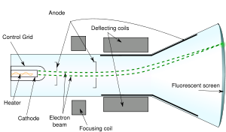
CRT (Cathode Ray Tube) Monitors

Slide 29
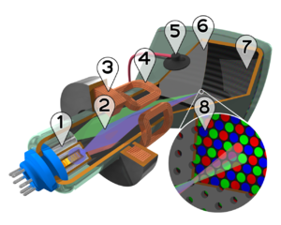
CRT (Cathode Ray Tube) Monitors

Slide 30
CRT (Cathode Ray Tube) Monitors
Cutaway rendering of a color CRT:
1. Electron guns 2. Electron beams
3. Focusing coils 4. Deflection coils
5. Anode connection
6. Mask for separating beams for red, green, and blue part of displayed image
7. Phosphor layer with red, green, and blue zones
8. Close-up of the phosphor-coated inner side of the screen

Slide 31
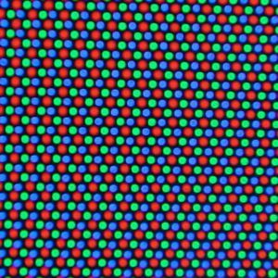
CRT (Cathode Ray Tube) Monitors
Close-up of a color CRT.

Slide 32
CRT (Cathode Ray Tube) Monitors
In a cathode ray tube, the "cathode" is a heated filament. The heated filament is in a vacuum created inside a glass "tube." The "ray" is a stream of electrons generated by an electron gun that naturally pour off a heated cathode into the vacuum. Electrons are negative. The anode is positive, so it attracts the electrons pouring off the cathode. This screen is coated with phosphor, an organic material that glows when struck by the electron beam.

Slide 33
CRT (Cathode Ray Tube) Monitors
There are three ways to filter the electron beam in order to obtain the correct image on the monitor screen:
  Shadow mask,
  Aperture grill and
  Slot mask.

Slide 34
CRT Features and Attributes …
Refresh Rate
In monitors based on CRT technology, the refresh rate is the number of times that the image on the display is drawn each second. If your CRT monitor has a refresh rate of 72 Hertz (Hz), then it cycles through all the pixels from top to bottom 72 times a second. Refresh rates are very important because they control flicker, and you want the refresh rate as high as possible. Too few cycles per second and you will notice a flickering, which can lead to headaches and eye strain.

Slide 35
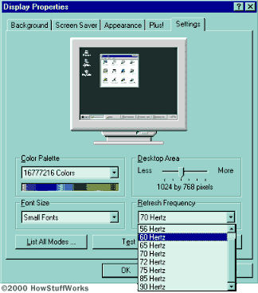
CRT Features and Attributes …
Refresh Rate…

Slide 36
CRT Features and Attributes …
Refresh Rate…
Because your monitor's refresh rate depends on the number of rows it has to scan, it limits the maximum possible resolution. Most monitors support multiple refresh rates. Keep in mind that there is a tradeoff between flicker and resolution, and then pick what works best for you. This is especially important with larger monitors where flicker is more noticeable. Recommendations for refresh rate and resolution include 1280x1024 at 85 Hertz or 1600x1200 at 75 Hertz.

Slide 37
LCD (Liquid Crystal Display) Monitors
Why called Liquid Crystal?
It turns out that liquid crystals are closer to a liquid state than a solid. It takes a fair amount of heat to change a suitable substance from a solid into a liquid crystal, and it only takes a little more heat to turn that same liquid crystal into a real liquid. This explains why liquid crystals are very sensitive to temperature and why they are used to make thermometers and mood rings. It also explains why a laptop computer display may act funny in cold weather or during a hot day at the beach.

Slide 38

LCD (Liquid Crystal Display) Monitors
Nematic Phase Liquid Crystals

Slide 39
LCD (Liquid Crystal Display) Monitors
Nematic Phase Liquid Crystals
One feature of liquid crystals is that they're affected by electric current. A particular sort of nematic liquid crystal, called twisted nematics (TN), is naturally twisted. Applying an electric current to these liquid crystals will untwist them to varying degrees, depending on the current's voltage. LCDs use these liquid crystals because they react predictably to electric current in such a way as to control light passage.

Slide 40
LCD (Liquid Crystal Display) Monitors
A liquid crystal display (commonly abbreviated LCD) is a thin, flat display device made up of any number of color or monochrome pixels arrayed in front of a light source or reflector. It is often utilized in battery-powered electronic devices because it uses very small amounts of electric power.

Slide 41
LCD (Liquid Crystal Display) Monitors
Basics
Liquid crystal display technology works by blocking light. Specifically, an LCD is made of two pieces of polarized glass (also called substrate) that contain a liquid crystal material between them. A backlight creates light that passes through the first substrate. At the same time, electrical currents cause the liquid crystal molecules to align to allow varying levels of light to pass through to the second substrate and create the colors and images that you see.

Slide 42
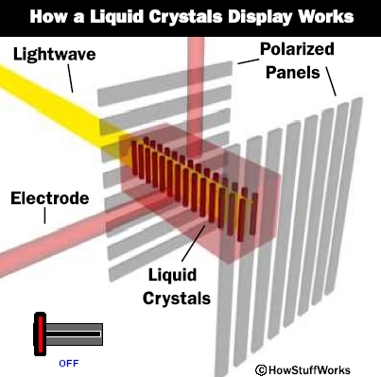
LCD (Liquid Crystal Display) Monitors

Slide 43
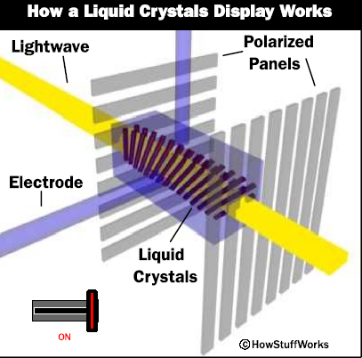
LCD (Liquid Crystal Display) Monitors

Slide 44
LCD (Liquid Crystal Display) Monitors
Creating an LCD ….
There's more to building an LCD than simply creating a sheet of liquid crystals. The combination of four facts makes LCDs possible:
Light can be polarized.
Liquid crystals can transmit and change polarized light.
The structure of liquid crystals can be changed by electric current.
There are transparent substances that can conduct electricity.
An LCD is a device that uses these four facts in a surprising way.

Slide 45
LCD (Liquid Crystal Display) Monitors
Creating an LCD
To create an LCD, you take two pieces of polarized glass. A special polymer that creates microscopic grooves in the surface is rubbed on the side of the glass that does not have the polarizing film on it. The grooves must be in the same direction as the polarizing film. You then add a coating of nematic liquid crystals to one of the filters. The grooves will cause the first layer of molecules to align with the filter's orientation. Then add the second piece of glass with the polarizing film at a right angle to the first piece. Each successive layer of TN molecules will gradually twist until the uppermost layer is at a 90-degree angle to the bottom, matching the polarized glass filters.

Slide 46
LCD (Liquid Crystal Display) Monitors
Creating an LCD
As light strikes the first filter, it is polarized. The molecules in each layer then guide the light they receive to the next layer. As the light passes through the liquid crystal layers, the molecules also change the light's plane of vibration to match their own angle. When the light reaches the far side of the liquid crystal substance, it vibrates at the same angle as the final layer of molecules. If the final layer is matched up with the second polarized glass filter, then the light will pass through.

Slide 47
LCD (Liquid Crystal Display) Monitors

Slide 48
LCD (Liquid Crystal Display) Monitors
Creating an LCD…
If we apply an electric charge to liquid crystal molecules, they untwist. When they straighten out, they change the angle of the light passing through them so that it no longer matches the angle of the top polarizing filter. Consequently, no light can pass through that area of the LCD, which makes that area darker than the surrounding areas.

Slide 49
LCD (Liquid Crystal Display) Monitors
Creating an LCD…
Building a simple LCD is easier than you think. Your start with the sandwich of glass and liquid crystals described above and add two transparent electrodes to it. For example, imagine that you want to create the simplest possible LCD with just a single rectangular electrode on it. The layers would look like this

Slide 50
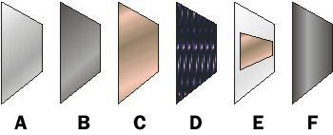
LCD (Liquid Crystal Display) Monitors

Slide 51
LCD (Liquid Crystal Display) Monitors
LCDs vs. CRTs
Advantages of LCD Monitors
  Require less power
  Smaller and weigh less
  More adjustable
  Less eye strain

Slide 52
LCD (Liquid Crystal Display) Monitors
LCDs vs. CRTs
Advantages of CRT Monitors
  Less expensive
  Better color representation
  More responsive
  Multiple resolutions
  More rugged

Slide 53
Plasma Display Monitors
Basics
A plasma display panel (PDP) is a type of flat panel display now commonly used for large TV displays (typically above 37-inch or 940 mm). Many tiny cells located between two panels of glass hold an inert mixture of noble gases (neon and xenon). The gas in the cells is electrically turned into a plasma which then excites phosphors to emit light.

Slide 54
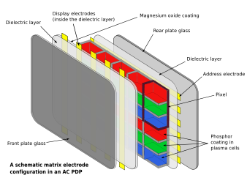
Plasma Display Monitors
General characteristics

Slide 55
Plasma Display Monitors
Functional Details
The xenon and neon gas in a plasma television is contained in hundreds of thousands of tiny cells positioned between two plates of glass. Long electrodes are also sandwiched between the glass plates, in front of and behind the cells. The address electrodes sit behind the cells, along the rear glass plate.

Slide 56
Plasma Display Monitors
Functional Details
The transparent display electrodes, which are surrounded by an insulating dielectric material and covered by a magnesium oxide protective layer, are mounted in front of the cell, along the front glass plate. Control circuitry charges the electrodes that cross paths at a cell, creating a voltage difference between front and back and causing the gas to ionize and form a plasma; as the gas ions rush to the electrodes and collide, photons are emitted.

Slide 57
Plasma Display Monitors
Functional Details
Every pixel is made up of three separate subpixel cells, each with different colored phosphors. One subpixel has a red light phosphor, one subpixel has a green light phosphor and one subpixel has a blue light phosphor. These colors blend together to create the overall color of the pixel, analogous to the "triad" of a shadow-mask CRT. By varying the pulses of current flowing through the different cells thousands of times per second, the control system can increase or decrease the intensity of each subpixel color to create billions of different combinations of red, green and blue. In this way, the control system can produce most of the visible colors.

